Slide 1
Collections and Generics

Slide 2
Objectives
What is the Generics? Benefits of Generics
Demo Generics Classes , Generics Methods and Generics Intefaces
Explain the Constraints on Type Parameters
Explain the Default Values in Generics
Overview about Collections
Explain about collection generic : List<T> class, SortedSet<T> class, Dictionary<TKey, TValue>, LinkList<T> class and IEnumerable<T> Interface
Demo using collection generic : List<T> class, SortedSet<T> class, and IEnumerable<T> Interface

Slide 3
Generics in C#

Slide 4
The Issue of Performance
A primary limitation of collections is the absence of effective type checking. This means that we can put any object in a collection because all classes in the C# extend from the object base class and this compromises type safety in C# language
In addition, using collections involves a significant performance overhead in the form of implicit and explicit type casting (boxing and unboxing) that is required to add or retrieve objects from a collection

Slide 5
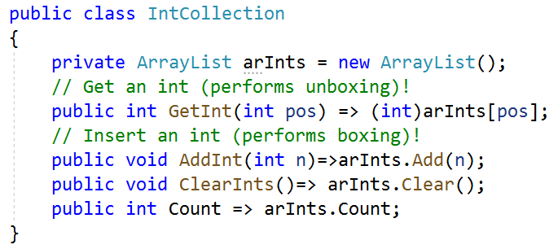
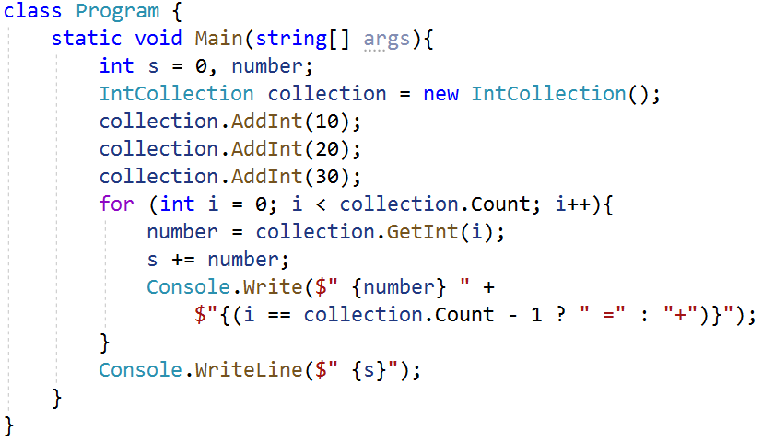

The Issue of Performance

Slide 6
The Issue of Performance
Problem with Boxing and UnBoxing Operations
A new object must be allocated on the managed heap
The value of the stack-based data must be transferred into that memory location
When unboxed, the value stored on the heap-based object must be transferred back to the stack
The now unused object on the heap will (eventually) be garbage collected

Slide 7
What is the Generics?
Generics introduce the concept of type parameters to .NET, which make it possible to design classes and methods that defer the specification of one or more types until the class or method is declared and instantiated by client code
Generic allows type (Integer, String, etc and user-defined types) to be a parameter to methods, classes, and interfaces
Generics are commonly used to create type-safe collections for both reference and value types. The .NET provides an extensive set of interfaces and classes in the System.Collections.Generic namespace for implementing generic collections

Slide 8
Benefits of Generics
Ensure type-safety at compile-time (ensure strongly-typed programming model)
Allow to reuse the code in a safe manner without casting or boxing:
Reduce run-time errors
Improve performance because of low memory usage as no casting or boxing operation is required
Can be reusable with different types but can accept values of a single type at a time
Generic delegates enable type-safe callbacks without the need to create multiple delegate classes
The Predicate<T> generic delegate allows us to create a method that implements our search criteria for a particular type and to use our method with methods of the Array type such as Find, FindLast, and FindAll
Notes:
More Dynamic Method : https://docs.microsoft.com/en-us/dotnet/api/system.reflection.emit.dynamicmethod?view=net-5.0

Slide 9
Generic Classes
Generic classes encapsulate operations that are not specific to a particular data type
The most common use for generic classes is with collections like linked lists, hash tables, stacks, queues, trees, and so on
When creating our generic classes, important considerations include the following:
Which types to generalize into type parameters
What constraints, if any, to apply to the type parameters
Whether to factor generic behavior into base classes and subclasses
Whether to implement one or more generic interfaces

Slide 10
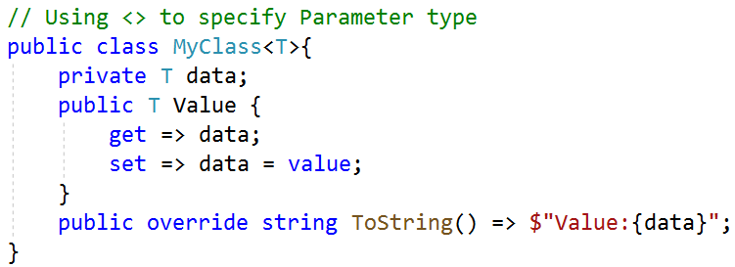
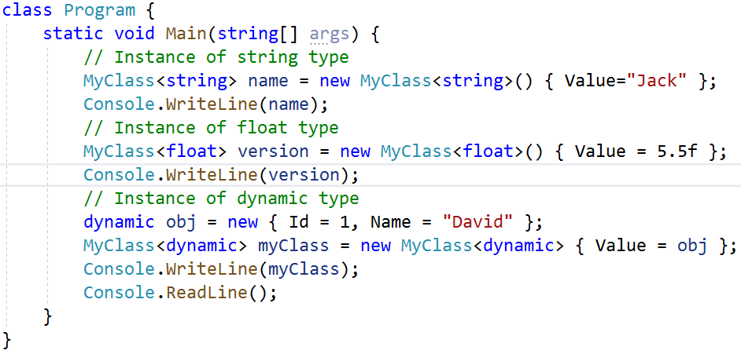
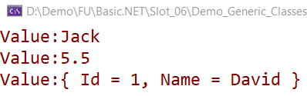
Generic Classes

Slide 11
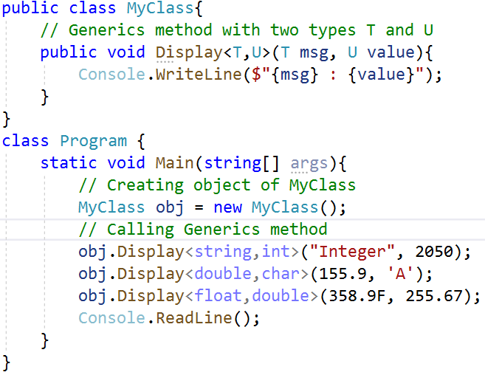
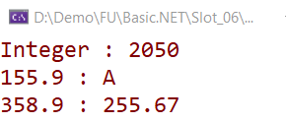
Generic Methods
With a generic method, the generic type is defined with the method declaration
Generic methods can be defined within non-generic classes

Slide 12
Constraints on Type Parameters
Constraints inform the compiler about the capabilities a type argument must have
Without any constraints, the type argument could be any type. The compiler can only assume the members of System.Object, which is the ultimate base class for any .NET type
Constraints are specified by using the where contextual keyword
The following table lists the various types of constraints:

Slide 13
Constraints on Type Parameters
Read by yourself
Constraint | Description
where T : struct | The type argument must be a non-nullable value type. The struct constraint implies the new() constraint and can't be combined with the new() constraint
where T : class | The type argument must be a reference type. This constraint applies also to any class, interface, delegate, or array type. T must be a non-nullable reference type
where T : class? | The type argument must be a reference type, either nullable or non-nullable. This constraint applies also to any class, interface, delegate, or array type
where T : notnull | The type argument must be a non-nullable type. The argument can be a non-nullable reference type or a non-nullable value type
where T : unmanaged | The type argument must be a non-nullable unmanaged type. The unmanaged constraint implies the struct constraint and can't be combined with either the struct or new() constraints
where T : new() | The type argument must have a public parameterless constructor. When used together with other constraints, the new() constraint must be specified last

Slide 14
Constraints on Type Parameters
Read by yourself
Constraint | Description
where T : <base class name> | The type argument must be or derive from the specified base class
where T : <base class name>? | The type argument must be or derive from the specified base class. T may be either a nullable or non-nullable type derived from the specified base class
where T : <interface name> | The type argument must be or implement the specified interface
where T : <interface name>? | The type argument must be or implement the specified interface. T may be a nullable reference type, a non-nullable reference type, or a value type. T may not be a nullable value type
where T : U | The type argument supplied for T must be or derive from the argument supplied for U. In a nullable context, if U is a non-nullable reference type, T must be non-nullable reference type. If U is a nullable reference type, T may be either nullable or non-nullable

Slide 15
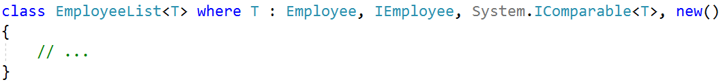
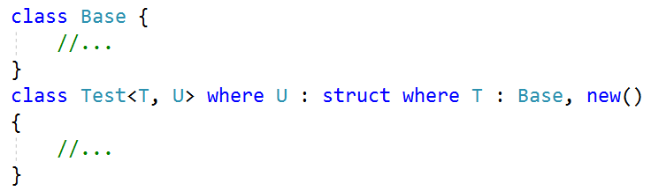
Constraints on Type Parameters
Multiple constraints can be applied to the same type parameter, and the constraints themselves can be generic types, as follows:
Constraining multiple parameters

Slide 16
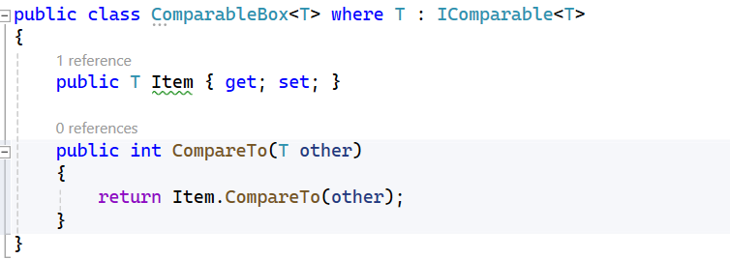
Constraints on Type Parameters
With a generic method, the generic type is defined with the method declaration
Generic methods can be defined within non-generic classes
The where T : IComparable<T> constraint specifies that the type parameter T must implement the IComparable<T> interface. This allows the CompareTo method to be defined within the class.

Slide 17
Generic Interfaces
It is often useful to define interfaces either for generic collection classes, or for the generic classes that represent items in the collection
The preference for generic classes is to use generic interfaces, such as IComparable<T> rather than IComparable, in order to avoid boxing and unboxing operations on value types
The .NET class library defines several generic interfaces for use with the collection classes in the System.Collections.Generic namespace
When an interface is specified as a constraint on a type parameter, only types that implement the interface can be used

Slide 18
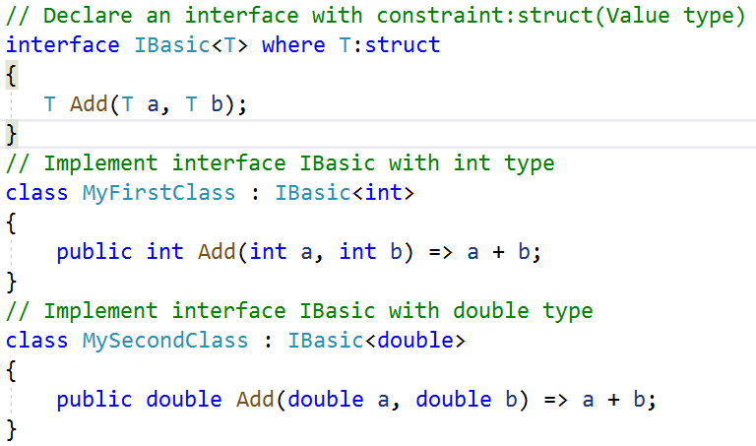
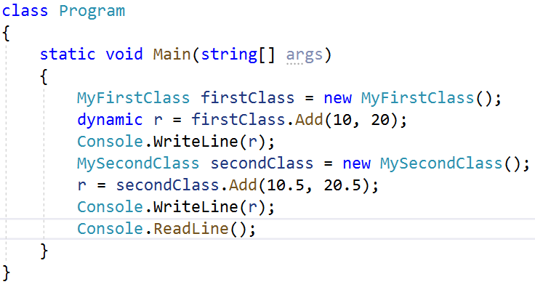
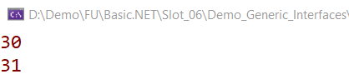
Generic Interfaces

Slide 19
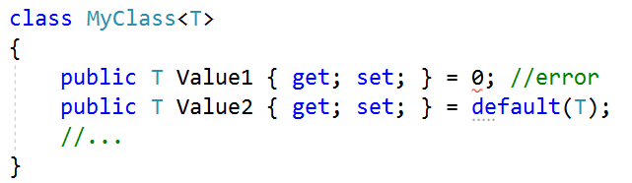
Default Values in Generics
With the default keyword, null is assigned to reference types and 0 is assigned to value types

Slide 20
Collections in C#

Slide 21
Collection Interfaces and Types
Most collection classes are in the System.Collections and System.Collections.Generic namespaces
Generic collection classes are located in the System.Collections.Generic namespace
Collection classes that are specialized for a specific type are located in the System.Collections.Specialized namespace
Thread-safe collection classes are in the System.Collections.Concurrent namespace
The following table describes the most important interfaces implemented by collections and lists

Slide 22
Key Interfaces Supported by Classes of System.Collections.Generic
Collection Interfaces and Types
Interface | Description
ICollection<T> | Defines general characteristics (e.g., size, enumeration, and thread safety) for all generic collection types
IComparer<T> | Defines a way to compare to objects
IDictionary<TKey,TValue> | Allows a generic collection object to represent its contents using key-value pairs
IEnumerable/IAsyncEnumerable | Returns the IEnumerator interface for a given object
IEnumerator | Enables foreach-style iteration over a generic collection
IList | Provides behavior to add, remove, and index items in a sequential list of objects
ISet | Provides the base interface for the abstraction of sets

Slide 23
Classes of System.Collections.Generic
Collection Interfaces and Types
Classes | Supported Key Interfaces | Description
Dictionary<TKey,TValue> | ICollection<T>,IDictionary<TKey,TValue>, IEnumerable<T> | This represents a generic collection of keys and values
LinkedList<T> | ICollection<T>, IEnumerable<T> | This represents a doubly linked list
List<T> | ICollection<T>,IEnumerable<T>, IList<T> | This is a dynamically resizable sequential list of items
Queue<T> | ICollection, IEnumerable<T> | This is a generic implementation of a first-in, first-out list
SortedDictionary<TKey,TValue> | ICollection<T>,IDictionary<TKey,TValue>, IEnumerable<T> | This is a generic implementation of a sorted set of key-value pairs
SortedSet<T> | ICollection<T>,IEnumerable<T>, ISet<T> | This represents a collection of objects that is maintained in sorted order with no duplication
Stack<T> | ICollection , IEnumerable<T> | This is a generic implementation of a last-in, first-out list

Slide 24
Generics Collections Demo
List<T> Class
SortedSet<T> Class
IEnumerable<T> Interface

Slide 25
Working with the List<T> Class
The List<T> is a collection of strongly typed objects that can be accessed by index and having methods for sorting, searching, and modifying list
List<T> equivalent of the ArrayList, which implements IList<T>
List<T> can contain elements of the specified type. It provides compile-time type checking and doesn't perform boxing-unboxing because it is generic
Elements can be added using the Add(), AddRange() methods or collection-initializer syntax
Elements can be accessed by passing an index. Indexes start from zero
List<T> performs faster and less error-prone than the ArrayList

Slide 26
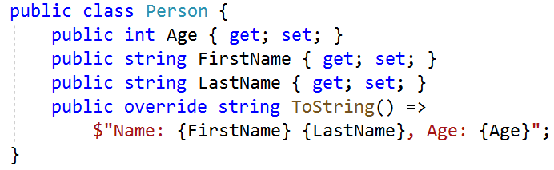
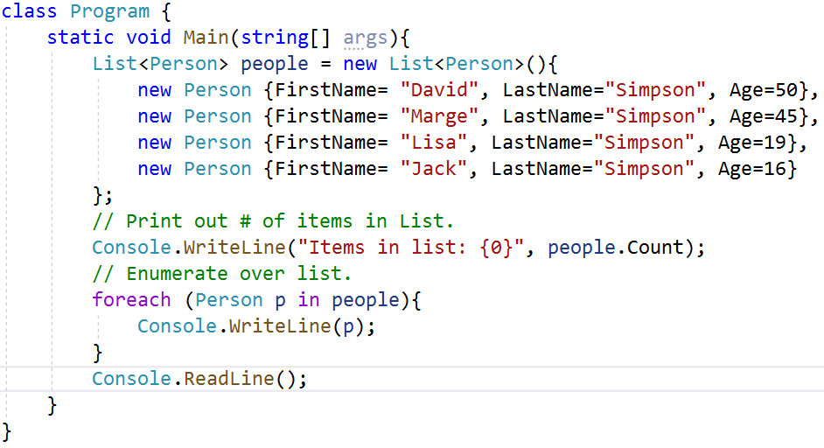
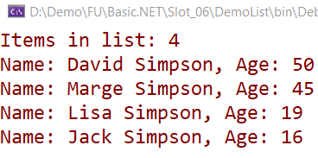
Working with the List<T> Class

Slide 27
Working with the SortedSet<T> Class
SortedSet is a collection of objects in sorted order. It is of the generic type collection and defined under System.Collections.Generic namespace
It also provides many mathematical set operations, such as intersection, union, and difference
It is a dynamic collection means the size of the SortedSet is automatically increased when the new elements are added
In SortedSet, the elements must be unique and the order of the element is ascending
It is generally used SortedSet class if we have to store unique elements and maintain ascending order
In SortedSet, the we can only store the same type of elements

Slide 28
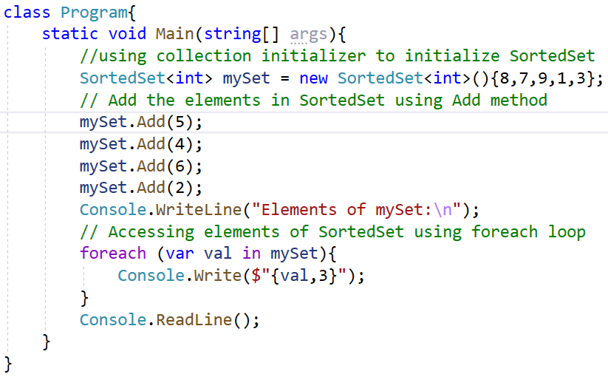
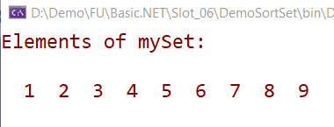
Working with the SortedSet<T> Class

Slide 29
The LinkedList<T> Class
LinkedList<T> Class is a generic type that allows fast inserting and removing of elements. It implements a classic linked list
Each object is separately allocated. In the LinkedList, certain operations do not require the whole collection to be copied
We can remove nodes and reinsert them, either in the same list or in another list, which results in no additional objects allocated on the heap
Each node in a LinkedList<T> object is of the type LinkedListNode<T>
The LinkedList class does not support chaining, splitting, cycles, or other features that can leave the list in an inconsistent state
The LinkedList is doubly linked, therefore, each node points forward to the Next node and backward to the Previous node

Slide 30
The Dictionary<TKey, TValue> Class
The Dictionary<TKey, TValue> is a generic collection that stores key-value pairs in no particular order
Dictionary<TKey, TValue> stores key-value pairs
Keys must be unique and cannot be null
Values can be null or duplicate
Values can be accessed by passing associated key in the indexer(e.g. myDictionary[key])
Elements are stored as KeyValuePair<TKey, TValue> objects

Slide 31
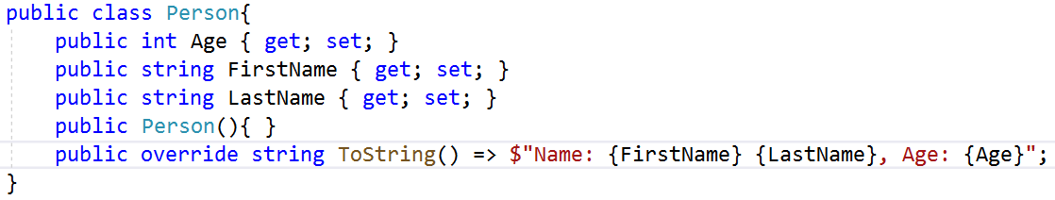
The IEnumerable<T> Interface
IEnumerable in C# is an interface that defines one method GetEnumerator which returns an IEnumerator interface. This allows readonly access to a collection then a collection that implements IEnumerable can be used with a for-each statement
Implement the IEnumerable<T> Interface :

Slide 32
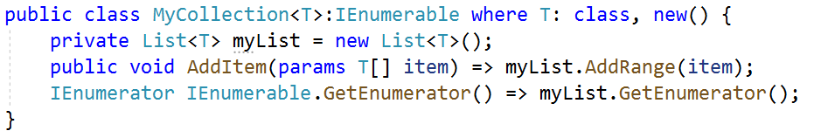
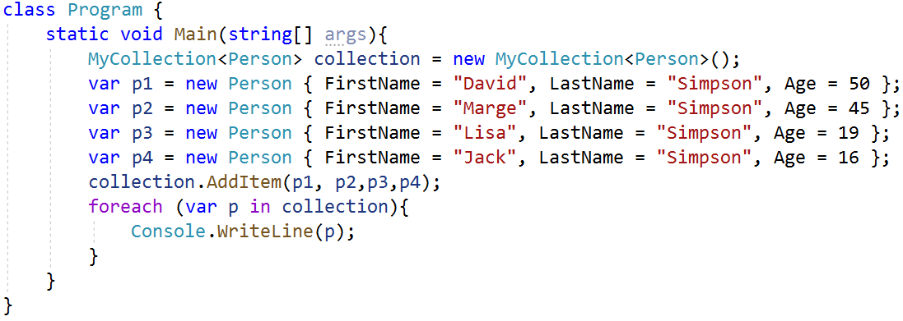
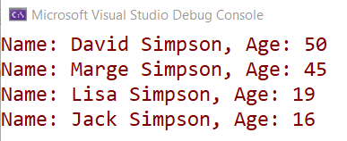
The IEnumerable<T> Interface

Slide 33
Summary
Concepts were introduced:
What is the Generics? Benefits of Generics
Demo Generics Classes , Generics Methods and Generics Intefaces
Explain the Constraints on Type Parameters
Explain the Default Values in Generics
Overview about Collections
Explain about collection generic: List<T> class, SortedSet<T> class, Dictionary<TKey, TValue>, LinkList<T> class and IEnumerable<T> Interface
Demo using collection generic: List<T> class, SortedSet<T> class, and IEnumerable<T> Interface

